Slide 1
SWA Project Data Input Services (DIS)
March 23, 2023
Maharishi international university

Slide 2
Date input Service goals
Many DIS services
Each service is in charge of one data source
Each service generates data at some rate
Data is numeric
Each service publish the data with its unique topic

Slide 3
Technologies used
Spring Boot version 3.0.4
Java JDK17
Apache Kafka 7.3.2
ReactJS 18.2.0
Axios 1.3.4 for REST calls
Bootstrap 5.2.3
Postman for testing

Slide 4
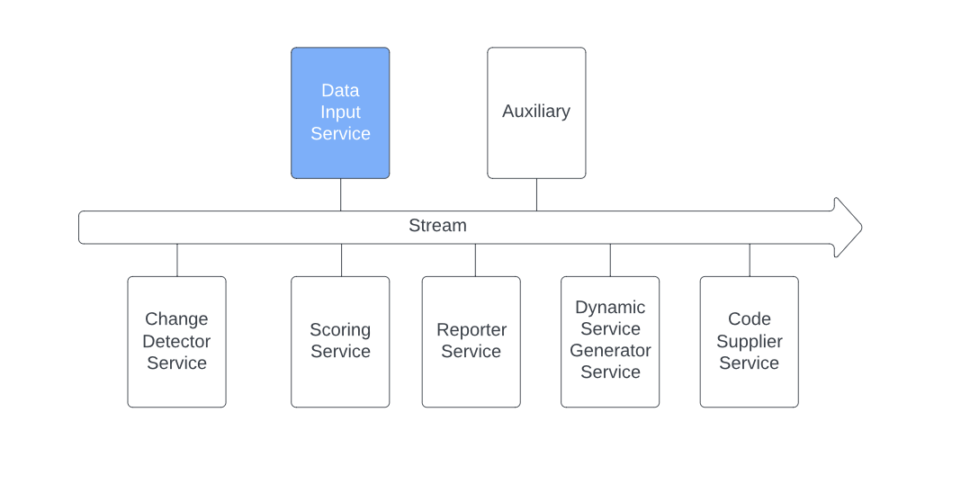
System Architecture

Slide 5
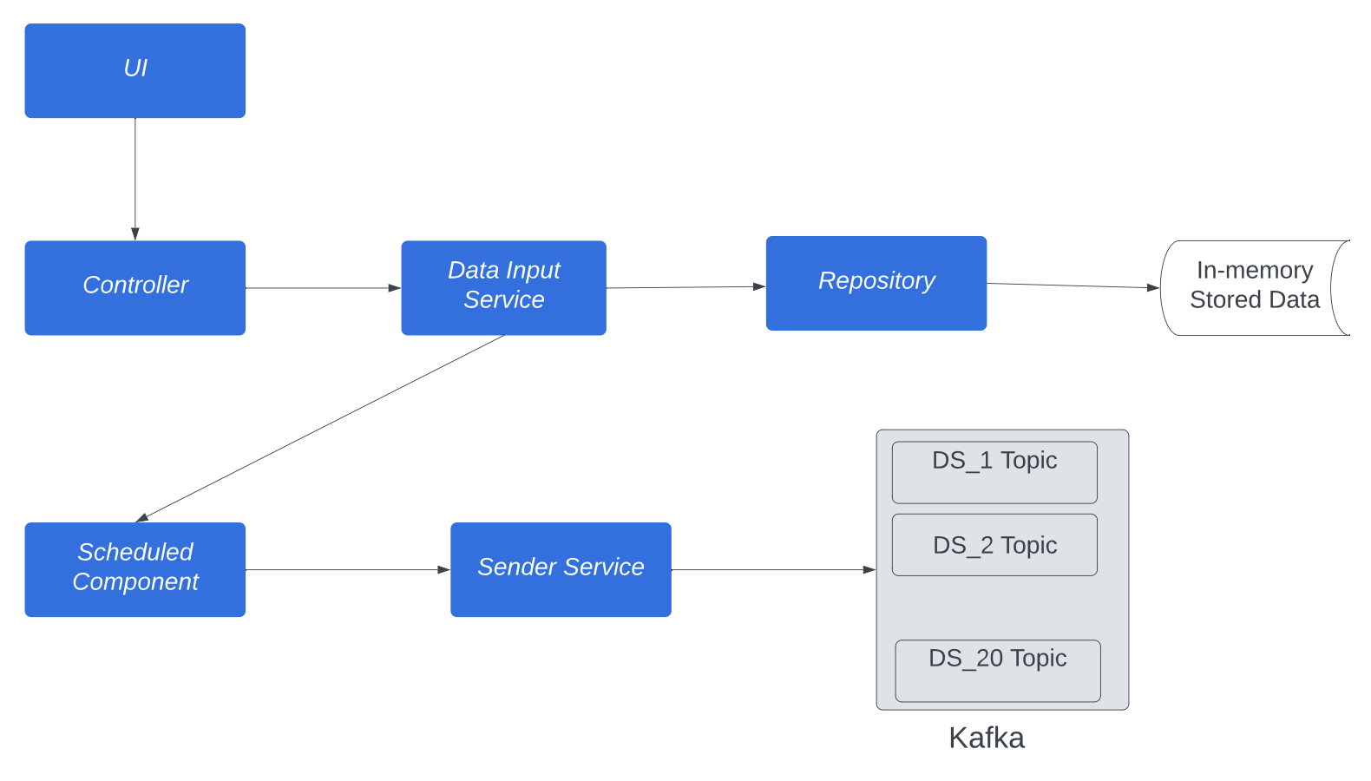
Data Input Service server-side Architecture

Slide 6
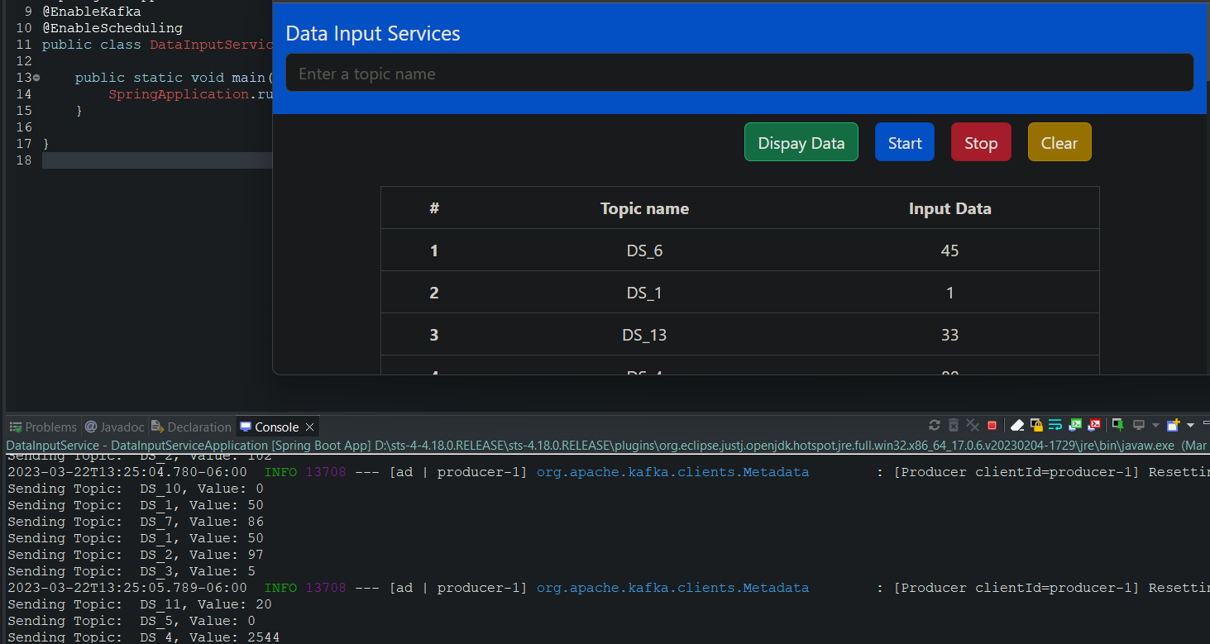
Front-end Design

Slide 7
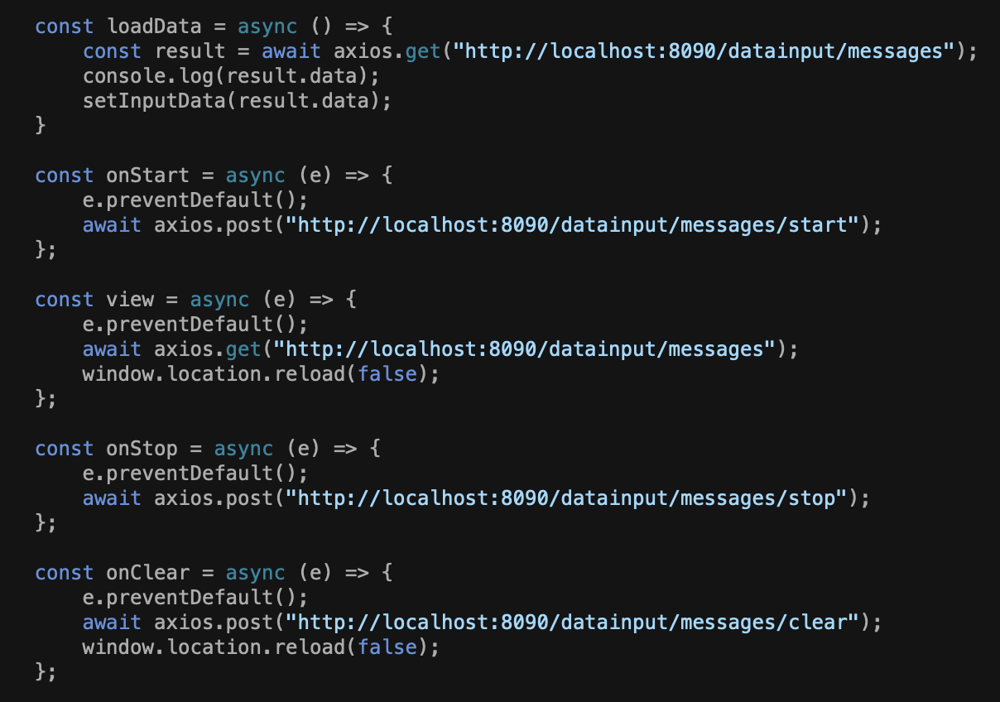
ReacT

Slide 8
Configuration
server.port=8090 spring.application.name=DataInputService spring.kafka.bootstrap-servers=localhost:9092 spring.kafka.consumer.group-id= gid spring.kafka.consumer.auto-offset-reset= earliest spring.kafka.consumer.key-deserializer= org.apache.kafka.common.serialization.StringDeserializer spring.kafka.consumer.value-deserializer= org.springframework.kafka.support.serializer.JsonDeserializer spring.kafka.producer.key-serializer= org.apache.kafka.common.serialization.StringSerializer spring.kafka.producer.value-serializer= org.springframework.kafka.support.serializer.JsonSerializer spring.kafka.consumer.properties.spring.json.trusted.packages= kafka app.topic.data-service-prefix=DS_ app.properties.upper-bound=100

Slide 9
Component
@Component public class DataInputScheduledTasks { @Autowired Sender sender; @Autowired DataInputService service;
@Value("${app.topic.data-service-prefix}") private String SERVICE_TOPIC_PREFIX;
@Value("${app.properties.upper-bound}") private long UPPER_BOUND;
private static final int DSI_1 = 1; private static final int DSI_2 = 2;
… private static final int DSI_3 = 20;
private long getRandomAddition(long upperBound){ return getRandomNumber(upperBound) + getRandomNumber(upperBound); }
@Scheduled(fixedRate = 1000) public void sendData1() { if (service.isEnabled()) { sender.send(SERVICE_TOPIC_PREFIX + DSI_1, getRandomNumber(UPPER_BOUND)); } } @Scheduled(fixedRate = 1500) public void sendData2() { if (service.isEnabled()) { sender.send(SERVICE_TOPIC_PREFIX + DSI_2, getRandomAddition(UPPER_BOUND)); } }

Slide 10
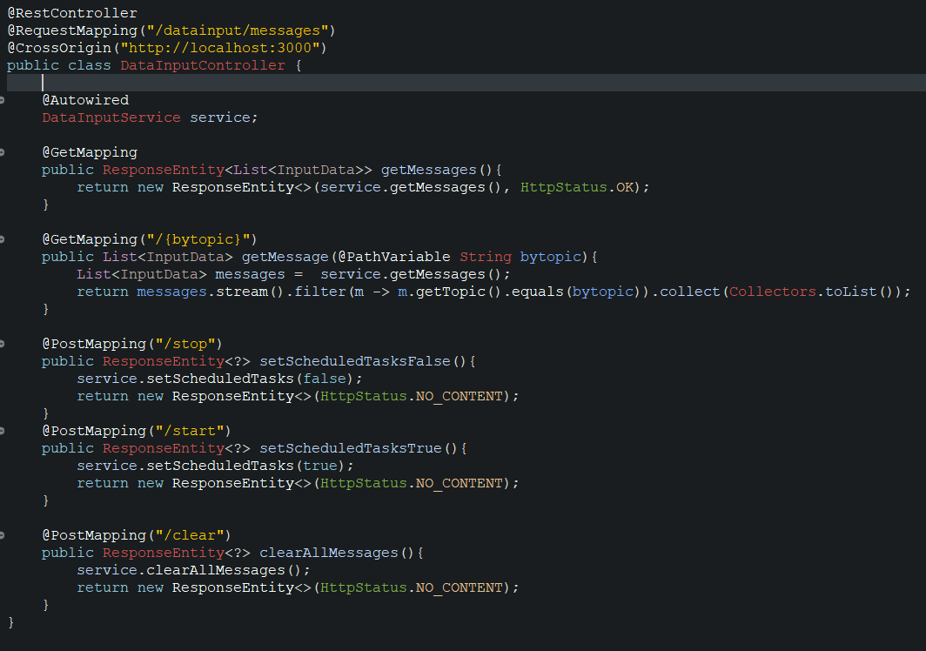
controller

Slide 11
Service data input
@Service public class DataInputService { @Autowired DataInputRepository repository; private boolean enabled; public boolean isEnabled() { return enabled; } public void addMessage(String message){ repository.save(message); } public List<String> getMessages(){ return repository.findAll(); } public void clearAllMessages(){ repository.clear(); } public void setScheduledTasks(boolean enabled){ this.enabled = enabled; } }

Slide 12
Service sender
@Service public class Sender { @Autowired KafkaTemplate<String, Long> kafkaTemplate; @Autowired DataInputService service; public void send(String topic, Long number) { kafkaTemplate.send(topic, number); System.out.println("Sending Topic: " + topic + ", Value: " + number); service.addMessage("Sending Topic: " + topic + ", Value: " + number); } }

Slide 13
repository
@Repository public class DataInputRepository { private List<String> messages; public DataInputRepository() { this.messages = new ArrayList<>(); } public List<String> getMessages() { return messages; } public void save(String message) { this.messages.add(message); } public void clear(){ this.messages.clear(); } public List<String> findAll() { return this.messages; } }

Slide 14
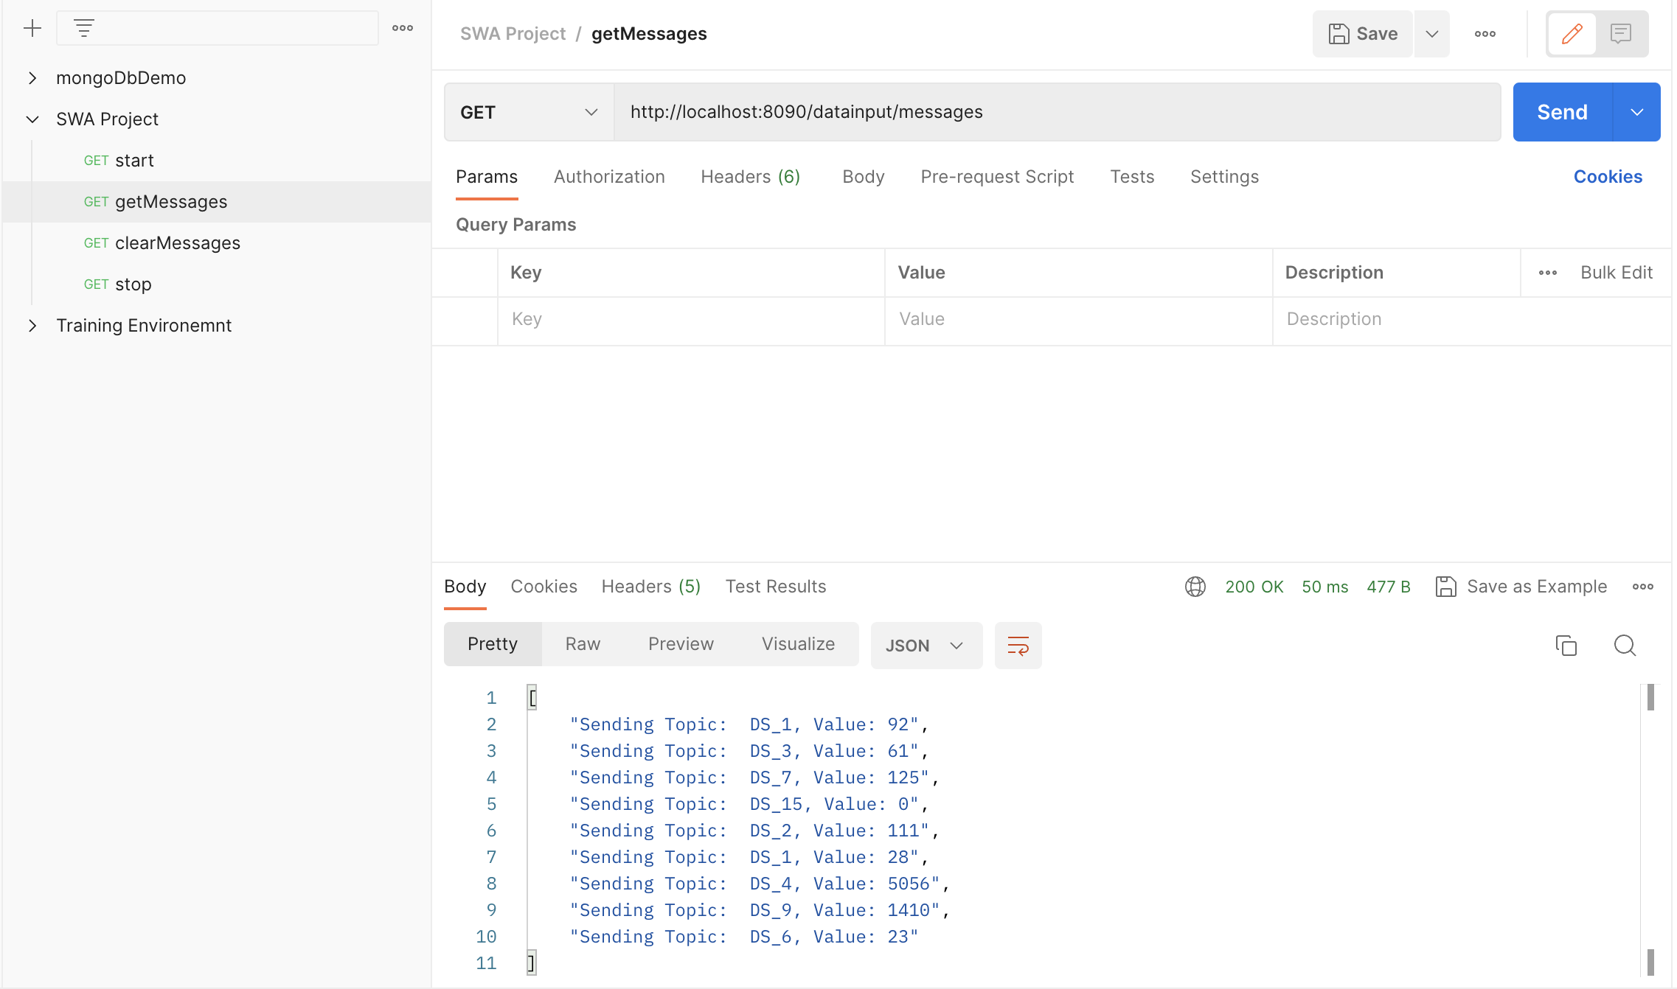

Slide 15
Thank you
Team Members:
1. Ali Bouzar
2. Roula Sabbagh
3. Sandip Kumar Mahato
4. Timothy Jake Baniel Flordeli

